Slide 1



Understanding autism without the disorder!
Prof Andrew Cashin – SCU
Dr Matthew Snow – JMS Allied Services
Dr Peter Silberberg - GP

Slide 2

ACKNOWLEDGEMENT OF COUNTRY

Slide 3
Thanks to our sponsor -

Slide 4

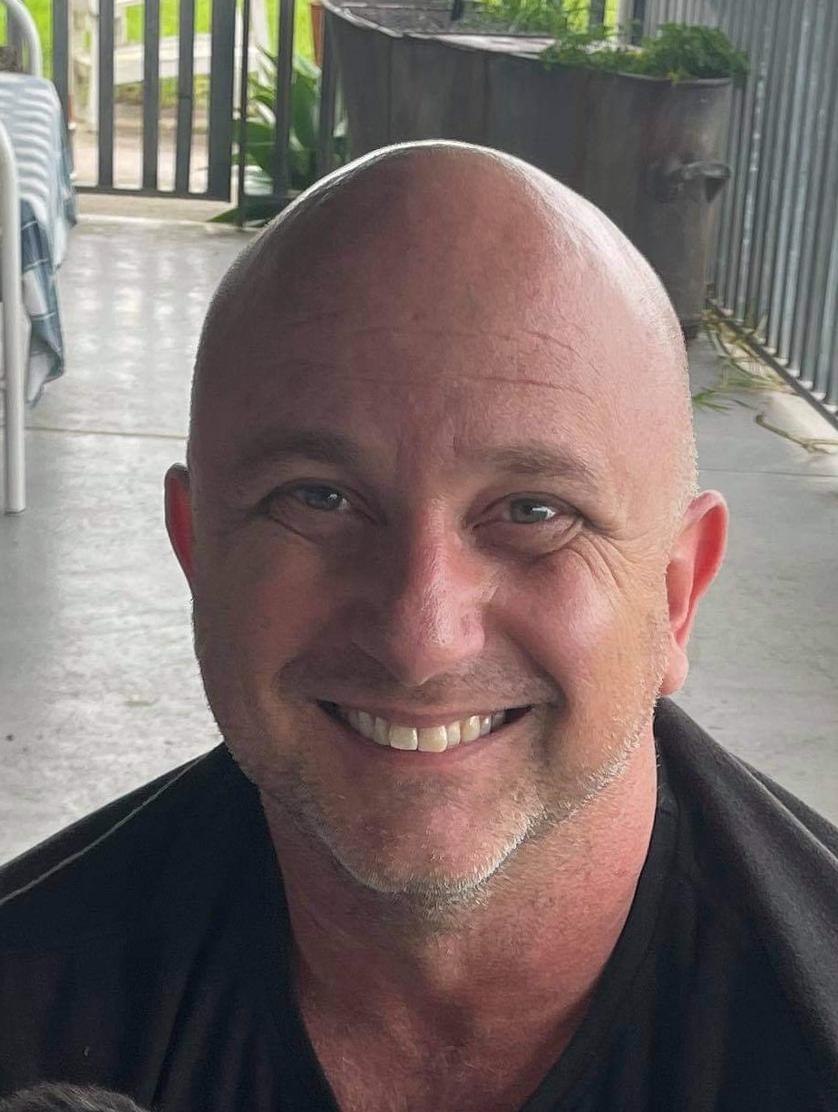
Prof. Andrew Cashin & Dr. Matthew Snow

Slide 5
Learning Outcomes
Increase your understanding of autism
Hear a lived experience from a parent of a child with autism
Improve your understanding about the NDIS application process
Learn some handy tips for your interactions with patients with autism

Slide 6
True or False
Autism is a condition that mainly affects children
Notes:
F - Autism is a lifelong neurodevelopmental difference. Many children have a diagnosis delayed until adulthood.
Pete to Andrew

Slide 7
True or False
The ratio of male to female people with autism is between 1:3 and 1:2 if including accompanying ID
Notes:
T - This may mean that many female adults are diagnosed as adults.
One reason female children may have a missed diagnosis is that diagnostic criteria have been shaped around the experiences of male children

Slide 8
True or False
Autism is a disease or disorder and should be eradicated, prevented, treated or cured
Notes:
F - this would represent the medical model of disease.
The autistic community does not view autism as a disease to be cured or fixed.
An analogy to describe autism is:
Additional Slide - just because a PlayStation cannot read an Xbox game does not mean it is broken or has a processing error – it is just a different operating system.

Slide 9
True or False
The Autism Spectrum is linear with mild at one end and severe at the other
Notes:
F - Classifying Autistic people into levels and using high- and low-functioning labels fails to capture the critical fact that autism is not static, but rather fluid in nature (Figure 1).26
The skills and capabilities of an Autistic person will develop throughout their lifespan. Therefore, it is unlikely that health professionals can predict the long-term outcomes and capabilities of Autistic people with any certainty.
Further, it is impossible to make a one off assessment doing one interview in your consultation room.
Use the spectrum colour wheel as a slide
Additional Slide - 3.1 spectrum color wheel

Slide 10
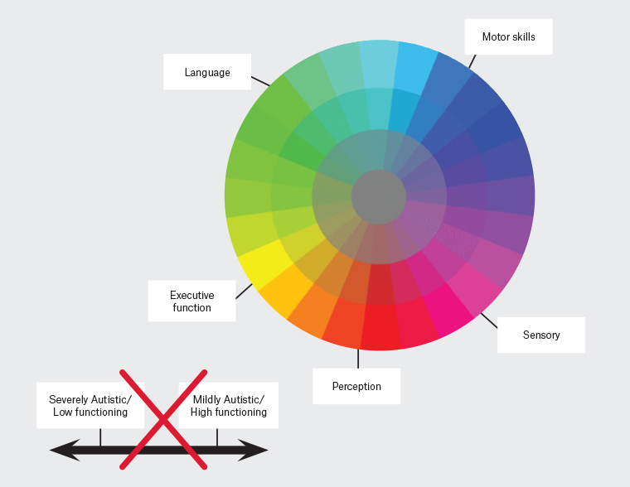
AJGP Volume 50, Issue 3, March 2021 ‘Autistic’ or ‘with autism’? Why the way general practitioners view and talk about autism matters Pia Bradshaw Claire Pickett Mieke L van Driel Katie Brooker Anna Urbanowicz

Slide 11
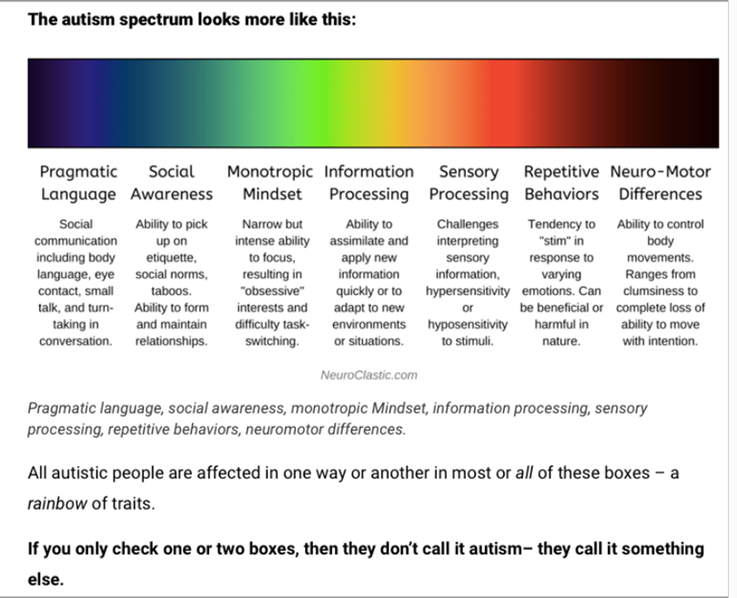



Slide 12
True or False
Continual use of words like mild or severe to describe an autistic person, is potentially damaging.
Notes:
T - the use of such terminology is harmful to Autistic people, their supporters and/or loved ones because it reinforces the stigma, myths and misinformation that create barriers for Autistic people and prevents the acceptance of Autistic people within society.
Autism should be viewed as a spectrum condition comprising different language, sensory, executive function, perception and motor skills, whereby every Autistic person possesses a unique profile with varying degrees of strengths and challenges in each category; this profile is fluid across the lifespan (Figure 1).
Language should focus on specific support needs rather than ‘severity’

Slide 13
As Adam Walton, an Autistic self-advocate, says so eloquently:27
[So-called] mild autism doesn’t mean one experiences autism mildly … It means YOU experience their autism mildly.

Slide 14
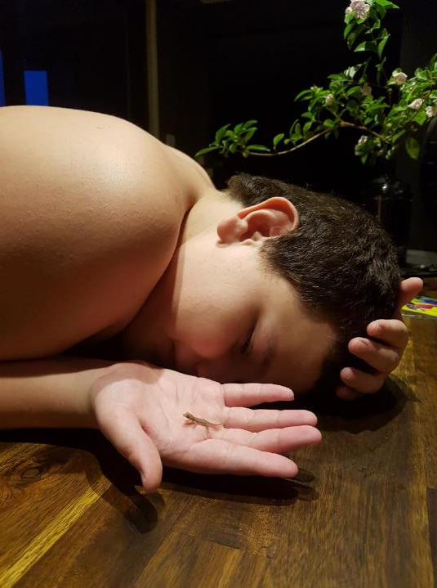
Lachlan
A.K.A
penguin, Gecko, Beluga or axolotl
Notes:
Matt, if you are able talk about your experience of what is was like pre diagnosis and then the experience of diagnosis as well.
Let us know the best way to prompt you. It maybe that we just ask you talk about it and then we can ask questions as you talk, if that works for you?
It would be helpful if you also leave the audience with some take home messages.

Slide 16
NDIS
Children under 6
  Under 6 – referral – OT, clinical psychologist, paediatrician
Disability advocacy service
Example of form that GP is asked to complete
Positive NDIS stories

Slide 17
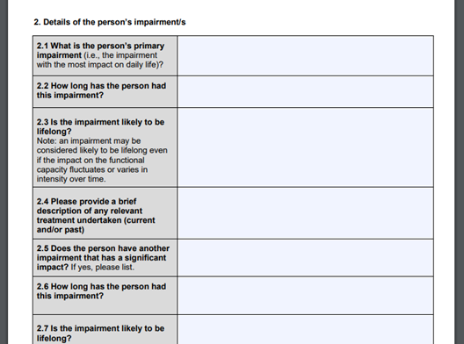
NDIS Application

Slide 18
Improving interactions in practice
Appointments and waiting room
Consultations
Preventative health
Immunisations
Health Pathways page that has some more details (https://manc.communityhealthpathways.org/286873.htm) login - manchealth
  pw - conn3ct3d

Slide 19
Thanks to our sponsor -

Slide 20
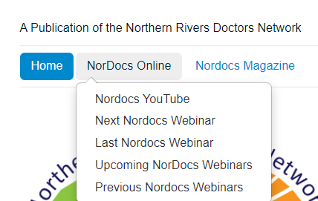
A reminder about our website address.
www.nordocs.org.au
There is a tab on the website directing you to the next webinar and a recording of the previous webinar.
Please also email us, if you would like to go on our email list for education events -
info@lists.nordocs.org.au
Join the Northern Rivers Doctors Group on Facebook – it is a private group
The Facebook group is a space for Medical Practitioners from the Northern Rivers to communicate, collaborate and advocate on medical issues affecting our community.

