Slide 1
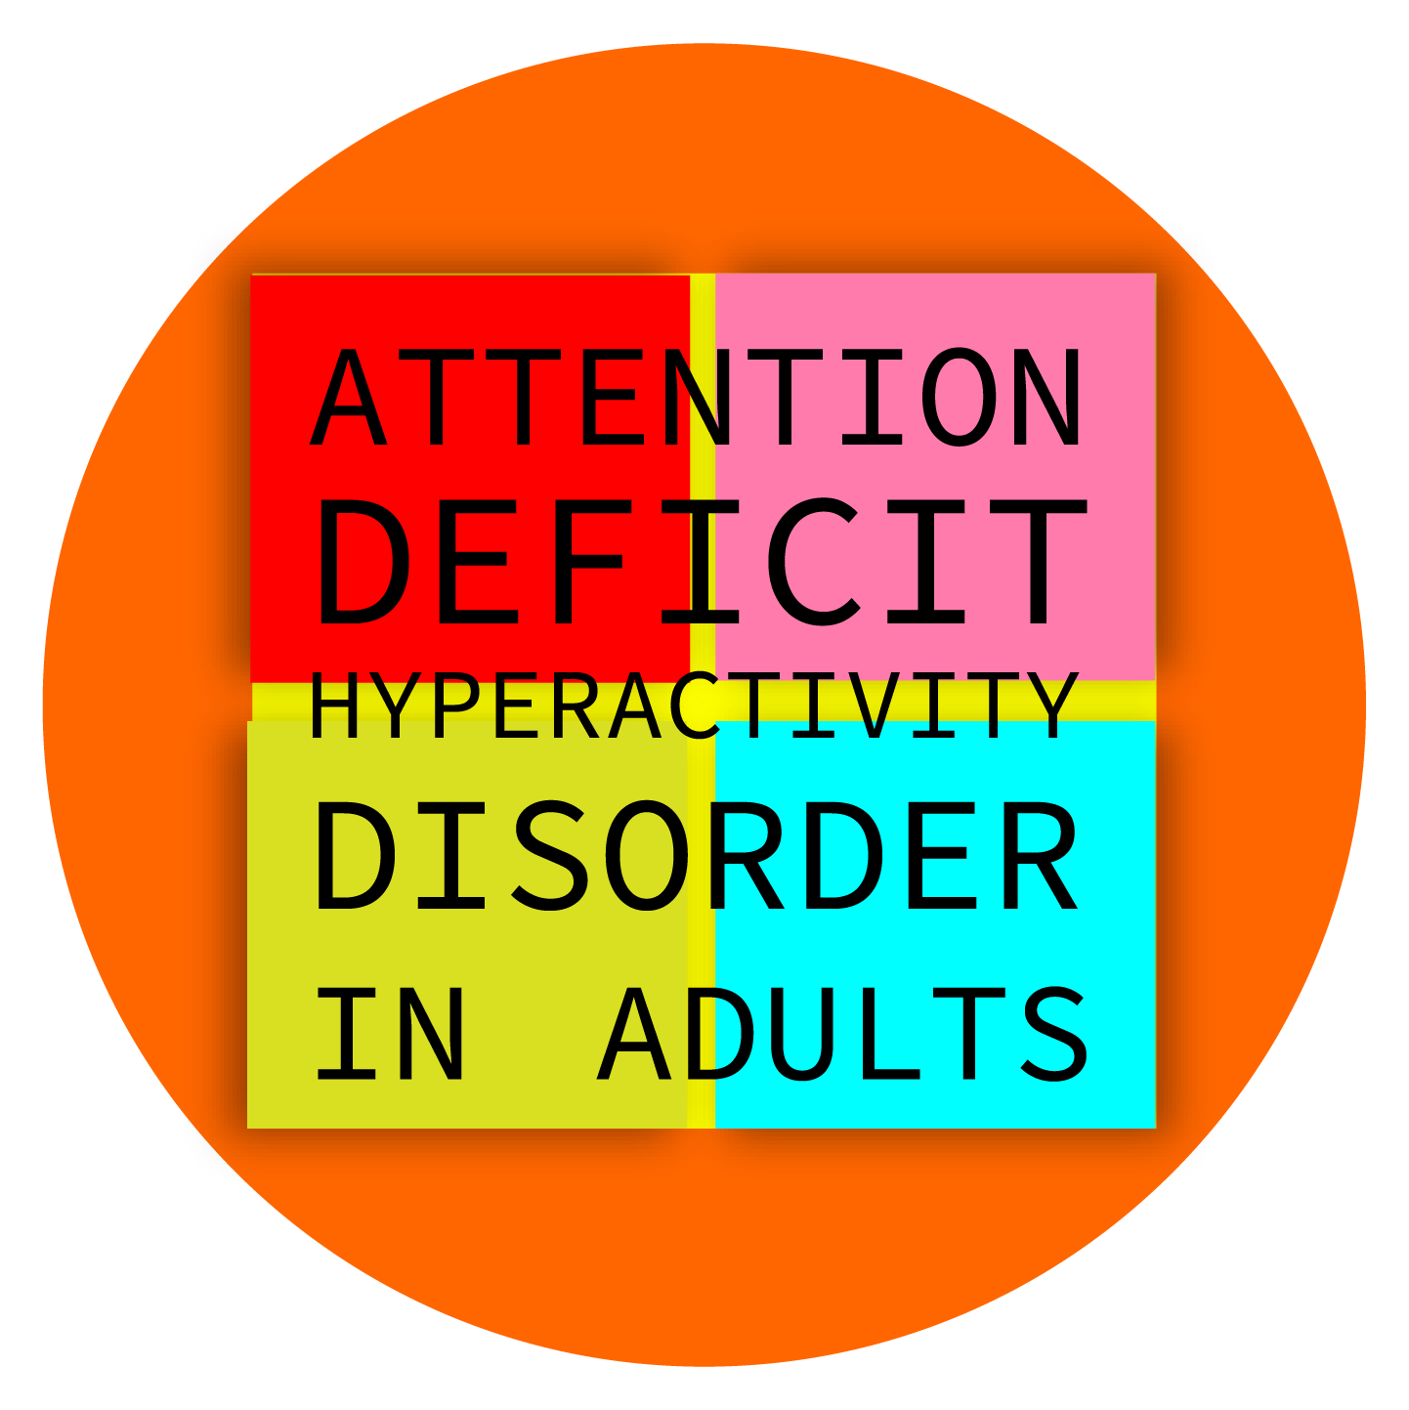

Welcome everyone to
tonight’s NorDocs webinar
Myth or Fact? ADHD in adults

Slide 2

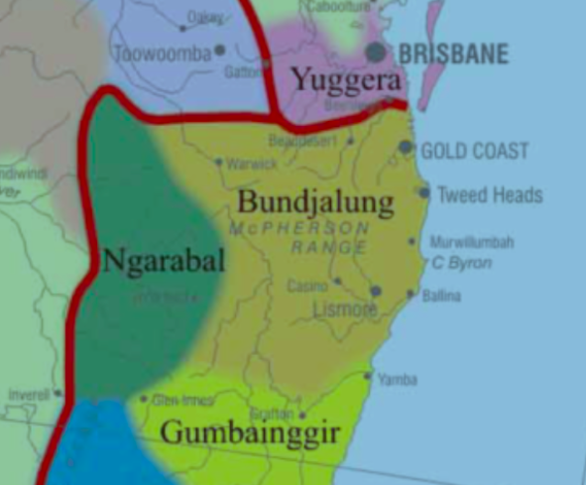
Acknowledgement of Country

Slide 3

NorDocs is a network of all doctors and medical students, living or working in our geographic footprint.
Our aim is to support all its members by improving the health of our North Coast community.
Education is a part of this process, including these webinars, our flagship quarterly magazine, and we very much hope, a return to FTF education in the future.

Slide 4


Special thanks
  to our presenters Drs Hugh Morgan and James Whan
  and to our sponsors Currumbin Clinic
currumbinclinic.com.au
Regarded as the centre of excellence in mental health on the gold coast, Currumbin Clinic is a 104 bed private mental health facility offering inpatient treatment, day patient programs, outpatient appointments and a mental health community service. Our multidisciplinary team and programs specialise in providing treatment for addictive disorders, mood disorders and mental health concerns that often go hand in hand.

Slide 5
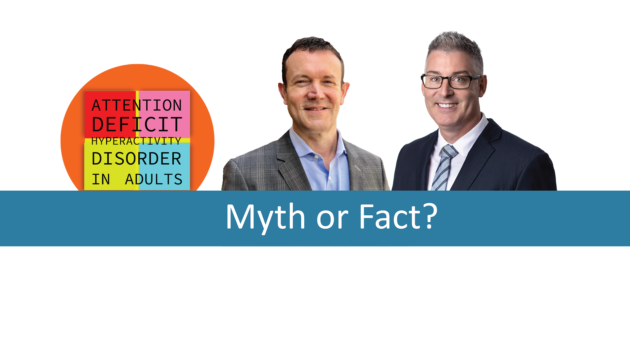
Welcome to Dr Hugh Morgan and Dr James Whan
Use the Chat box to ask questions during the webinar

Slide 6
Learning outcomes
Learning Outcomes:
At the end of this webinar, participants will
1. be up-to-date about general facts concerning ADHD in adults
2. better understand how to recognize ADHD in adults
3. understand how ADHD in adults is diagnosed
4. learn how to be a co-prescriber of stimulant medication with a psychiatrist

Slide 7
MYTH OR FACT?
  ADHD in adults is a separate entity to
  ADHD in childhood.
Notes:
‹#›

Slide 8
ADHD is a family affair
Adults with ADHD are far more likely to have children with the disorder- as many as 40-50% of their children will at least have traits of the disorder.
Clinicians are often asked to assess the spouses or children of their adult ADHD patients.
In children 4-10% worldwide^{1,2}
Persists into adulthood for two thirds of children³
In adults around 4.4% in USA⁴
Notes:
‹#›

Slide 9
MYTH OR FACT?
  All psychiatrists believe in ADHD.
Notes:
‹#›

Slide 10
MYTH OR FACT?
  If everyone could take stimulants
  we could all benefit.
Notes:
‹#›

Slide 11
MYTH OR FACT?
  Patients who are seeking a diagnosis of ADHD
  are mainly drug seeking.
Notes:
‹#›

Slide 12
MYTH OR FACT?
  ADHD is a serious psychiatric condition
  and is under diagnosed.
Notes:
‹#›

Slide 13
Why ADHD matters
Over 800,000 Australians are affected by ADHD.
The majority of those Australians are untreated.
ADHD was the most common mental disorder in children and adolescents (7.4%) in 2015.
Total financial cost of ADHD in 2019 was $20 billion.
Mortality rate of people with ADHD is ~2.6 times greater than those without ADHD.
People with ADHD taking medication have a 40% lower risk of car accidents.
Notes:
‹#›

Slide 14
MYTH OR FACT?
If your patient is a high functioning individual, perhaps even a doctor, you should still consider ADHD.
Notes:
‹#›

Slide 15
MYTH OR FACT?
I recognise the kids with ADHD. They destroy the consulting room in about 3 minutes.
Adults with ADHD are just the same.
Notes:
‹#›

Slide 16
Clues from clinical history
Time Management | Home/Work | Personal | Relationships
Procrastination | Disorganised | Emotional Dysregulation | Prone to blurting out, interrupting, oversharing
Frequently late | Forgetting, losing, misplacing things | Managing money | Low self-esteem – feeling stupid and different, a sense of underachievement, not performing at a level expected of self.
Overcommitting | Driving - prone to road rage, parking or speeding fines, DUI, loss of licence. | Sleep problems - delays going to bed, has difficulty switching off at night to get to sleep, with chronic sleep debt.

Slide 17
Clues from observation and MSE
Turning up late / DNA.
Incomplete paperwork / questionnaires.
Fidgeting, foot tapping.
Speech circumstantial, overinclusive, excitable.
Seems a bit scatty or vague.
Poor historian.
Generally feels overwhelmed.
Notes:
‹#›

Slide 18
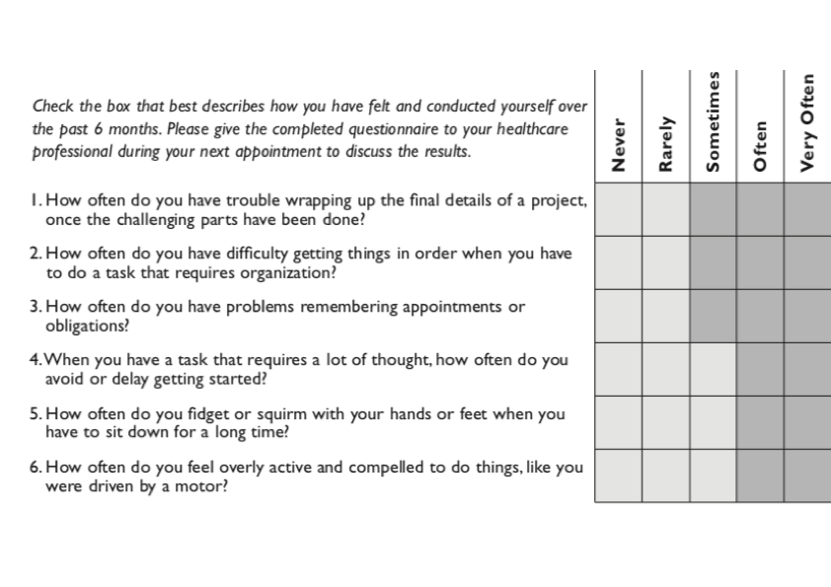
Adult Self-Report Scale-V1.1 (ASRS-V1.1) Screener
Notes:
‹#›

Slide 19
MYTH OR FACT?
It is common for ADHD to be part of other co-existing psychiatric diagnoses.
Notes:
‹#›

Slide 20
Treatment of comorbidities
Comorbidities are common
Treatment of ADHD often improves the symptoms of other diagnosis -comorbid may require treatment separate from ADHD
Do you treat ADHD or comorbidities first?
Notes:
‹#›

Slide 21
Summary
When Anxiety or Depression is co-morbid with ADHD treat whatever condition is more severe first.
When Bipolar Disorder is co-morbid with ADHD treat the mood disorder first before commencing any pharmacological treatment for ADHD
Psychotic symptoms - seek a 2nd opinion
When substance abuse/dependence is significantly co-morbid with ADHD the former needs to be treated first before pharmacological treatment of ADHD (using Atomoxetine as a first line agent) is attempted.
Notes:
‹#›

Slide 22
MYTH OR FACT?
After starting a patients with ADHD on stimulant medication they often tell you they feel calmer.
Notes:
‹#›

Slide 23
MYTH OR FACT?
Starting stimulant medication can be used diagnostically.
Notes:
‹#›

Slide 24
MYTH OR FACT?
GPs can prescribe stimulant medication.
Notes:
‹#›

Slide 25
Medication | Initiation | Dose
Methylphenidate IR (RITALIN) | Start at 5-10mg morning the first day; Further increments weekly at 5-10mg per week | Total daily dose typically varies between 10mg and 60mg/day Doses over 80mg/day uncommon
Methylphenidate longer-acting formulations | ER formulation - (CONCERTA): Start at 18 or 36 mg/day, taken once daily in the morning. | maximum of 72 mg/day Adjust dosage at weekly intervals - 18 mg
 | LA formulation – (RITALIN LA): Recommended initial dose is 20mg/day taken once daily in the morning | Adjust dose weekly in 10 mg increments Daily dose usually would not exceed 60mg
Dexamphetamine (SIGMA) | Start at 2.5-5.0mg morning the first day, Further increments weekly 2.5-5.0 mg | Total daily dose typically varies between 5mg and 30mg/day Doses over 40mg are uncommon
Atomoxetine (STRATTERA) | For adults or children >70kg, start at 40mg/day taken once daily for 3 days then increase to target dose of 80mg.³ | Target dose 80 mg/day Maximum dose 100mg³
Lisdexamfetamine (VYVANSE) | Recommended starting dose is 30 mg taken once daily in morning. ⁵ | Dose my be adjusted by 20 mg weekly up to 70 mg daily. ⁵
Guanfacine (TGA approved only in children aged 6-17 years inclusive) | Recommended starting dose is 1 mg morning or night. | Increase dose by 1 mg weekly up to max of 7 mg daily in monotherapy. Adjunctive therapy with stimulants – dosing 1-4 mg.
Notes:
‹#›

Slide 26
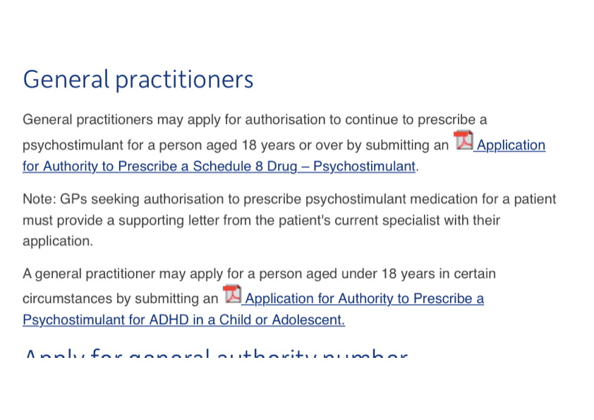
https://www.health.nsw.gov.au/pharmaceutical/doctors/Pages/prescribe-psychostimulant.aspx

Slide 27
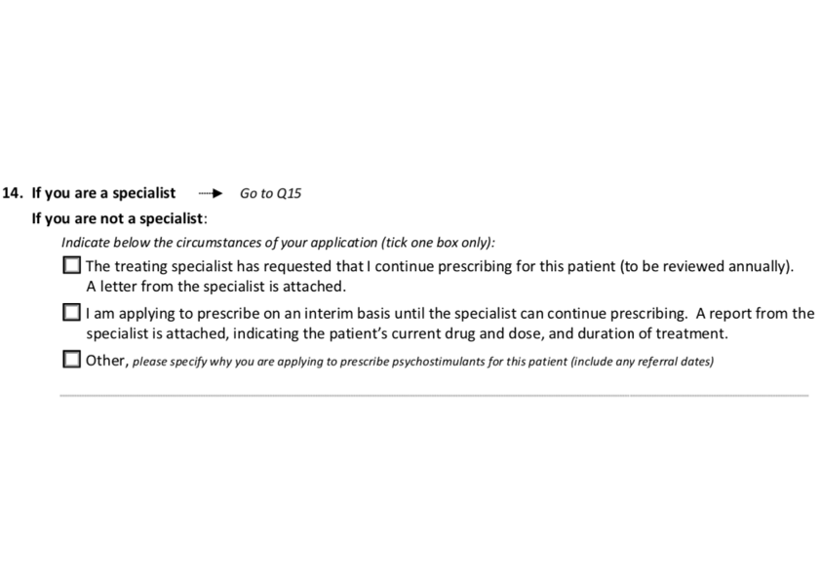
Initial application must have attached specialist letter within 12 months.
- You will receive an AUTH number that has to be written on the script
- This is separate to the PBS Auth number
Any break in treatment needs new psychiatrist referral.
GPs can apply for lower doses, but not higher doses, without specialist letter
- NSW Auth number is 02 9424 5923

Slide 28
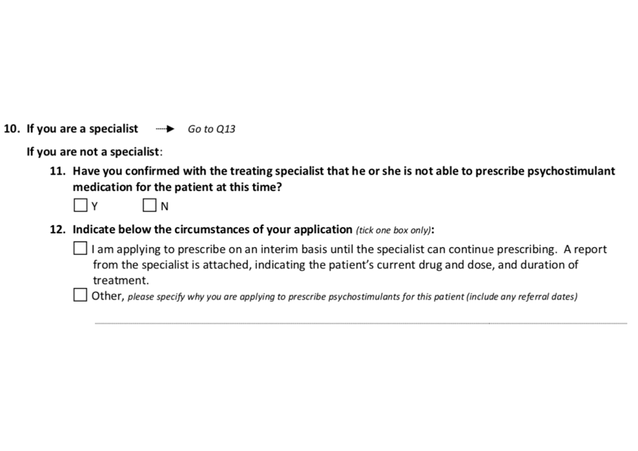
For patients under 18 years of age

Slide 29
Summary
Decrease stigma
ADHD is undertreated, not overtreated
Remember ADHD is a “family affair”
Think about ADHD with and without comorbidities
Consider screening questionnaires.
Co-prescriber stimulant medications with psychiatrist

Slide 30
MYTH OR FACT?
Questions.
Notes:
‹#›

Slide 31
Dr Hugh Morgan
Dr James Whan
Consult
Mullumbimby Comprehensive Health Centre
Phone: (02) 9212 4445
Fax: (02) 9212 7444
Email: info@mindcare.com.au
Website: www.mindcare.com.au
Consult
Referrals can be sent to either
- Level 1 Station st Bangalow 2479
Or
- 37 Bilinga st Currumbin 4223

Slide 32
Mystery Guest

Slide 33
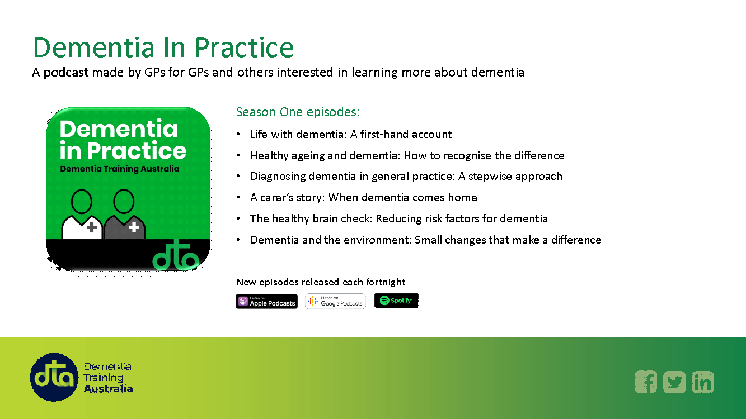

Slide 34

Our next webinar will be on
13 October 2021
Ophthalmic Conditions in General Practice
Dr Niall Aboud
Please answer the poll for the November Webinar.
When you log out of zoom, please complete the brief survey which will trigger your certificate for CPD points, and register for the next webinar.

Slide 35

A reminder about our website address.
www.nordocs.org.au
There is a tab on the webpage directing you to the next webinar and a recording of the previous webinar.
Please also email us, if you would like to go our email list for education events -
nordocs-events@lists.nordocs.org.au
Join the Northern Rivers Doctors Group on Facebook – it is a private group
The Facebook group is a space for Medical Practitioners from the Northern Rivers to communicate, collaborate and advocate on medical issues affecting our community.

