Slide 1



“Breathe Easier”
A team approach to restrictive lung disease.
Faculty
Dr Joe Churton
Dr Joe Duncan
Dr Bleigh Mupunga
Dr Doug Gray
Lyn Menchin (Respiratory Nurse)
Rocco Mico (Physiotherapist)
Facilitator
Dr David Glendinning
Coordinator
Dr Nathan Kesteven

Slide 2
Learning Objectives
At the end of this event participants will:
Recognise features of history and examination consistent with interstitial lung disease.
Identify patients at risk of rapidly progressive interstitial lung disease who require urgent treatment.
Understand referral pathways and available supports for respiratory patients in Northern NSW
Develop management plans for patients with end stage interstitial lung disease in the community

Slide 3
Case 1 – Jim
62-year-old man
Works in excavation, some reported asbestos exposure working as a builders apprentice in 1970’s
Current smoker, started age 16 and smokes 10/day
Past medical history includes hypertension (Irbesartan), Osteoarthritis and Hypercholesterolaemia (Rosuvastatin).

Slide 4
Jim – Presenting Complaint
12 months of exertional breathlessness with a dry cough
Difficulty walking up his driveway at home
No weight loss, fevers or infective symptoms
Does not complain of recurrent respiratory infections
The cough is new in the last 12 months, not productive

Slide 5
Jim – Examination
Haemoglobin saturation 94% breathing room air
Blood pressure 150/80
Digital clubbing
Normal heart sounds, no peripheral oedema
Fine Velcro like crackles bilaterally at the lung bases

Slide 6
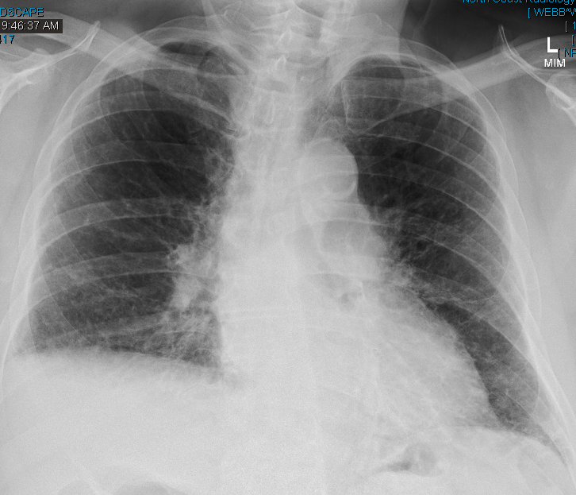

Slide 7
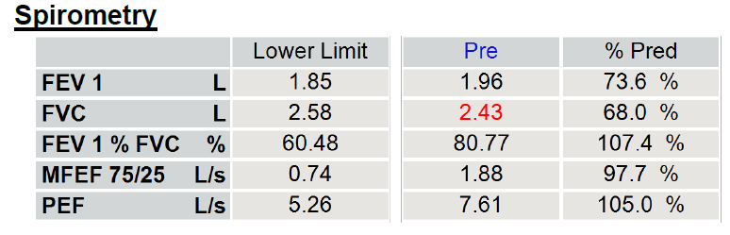
Jim – Spirometry

Slide 8
Jim– Approach to investigation

Slide 9
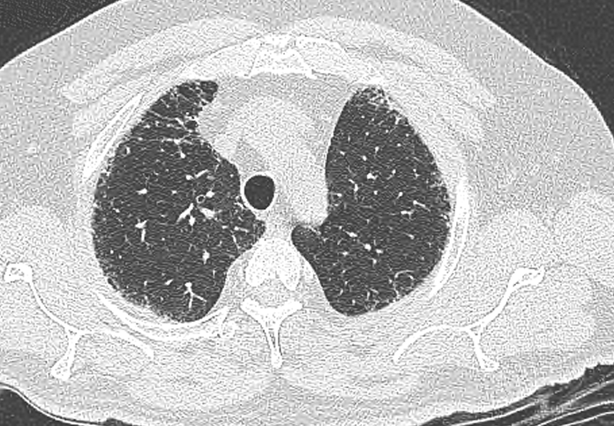

Slide 10
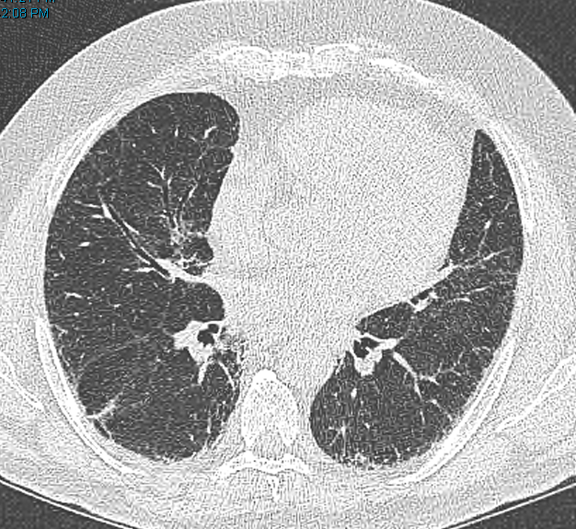

Slide 11
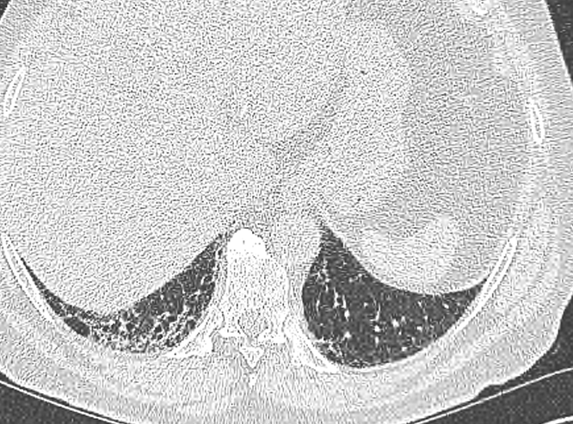

Slide 12
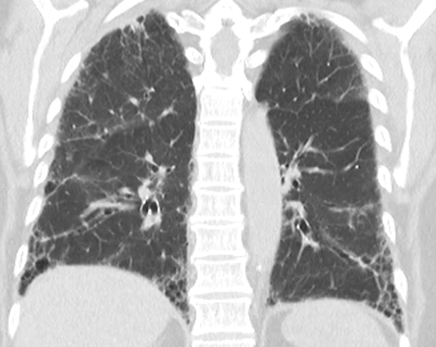

Slide 13
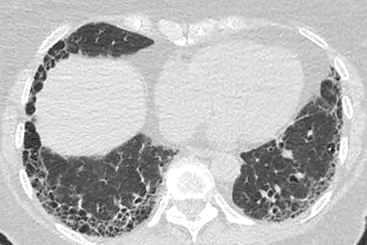

Slide 14
Jim – Next steps
Referral to Respiratory
  How would this be triaged?
  What features would make this more or less urgent?
  What further investigation would help?

Slide 15
Jim– Management Options

Slide 16
Jim – Therapy and Monitoring
Discussed at an MDT, confirmed to have IPF and commenced on Nintedanib *anti fibrotic
3 Monthly bloods to monitor liver function
Common side effects (nausea, diarrhoea…)
6 monthly lung function and respiratory review

Slide 17
Case 1 – ‘take-home’ messages
Interstitial lung disease encompasses a range of conditions affecting the lung parenchyma including IPF (the most common), hypersensitivity pneumonitis, sarcoidosis and many others.
Occupational and medication history may help identify a cause.
The presenting complaint is often dry cough and insidious onset of exertional breathlessness in a person aged 50 or over.
A reduced FVC on spirometry with a preserved FER helps differentiate between ILD and airways disease.
Early referral for antifibrotic therapy is important to reduce the rate of decline in lung function.

Slide 18
Case 2 - Michelle
Industrial chemist – now working from home
    Exposure to silica and phosphates
Lives with 2 young children and husband
10 pack year smoking history
Past history of asthma since childhood (ICU admissions) and obesity (BMI 43), depression
Medications – Symbicort 200/6, Montelukast, Fluoxetine

Slide 19
Michelle – Presenting Complaint
Viral exacerbation of asthma (influenza A) admitted with wheeze and breathlessness
Managed for asthma with prednisone and bronchodilators
In retrospect had been more breathless for months

Slide 20
Michelle – Examination
Haemoglobin saturation 93% breathing room air
No clubbing
No rash, peripheral arthropathy or muscle tenderness
Fine Velcro like crackles bilaterally

Slide 21
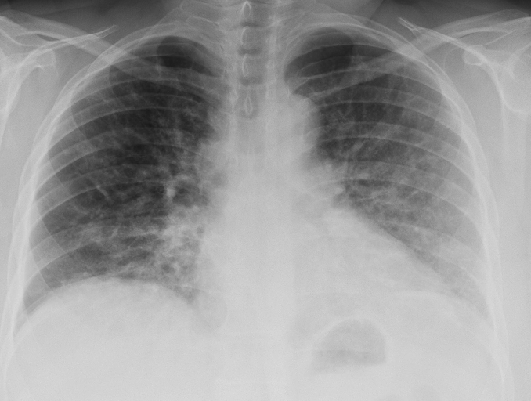

Slide 22
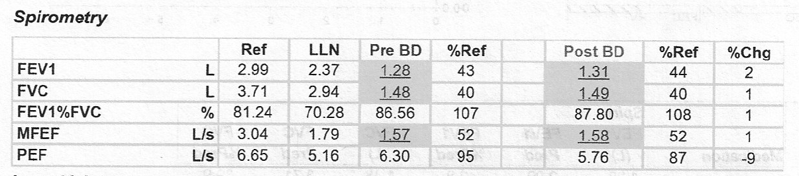
Michelle – Spirometry

Slide 23
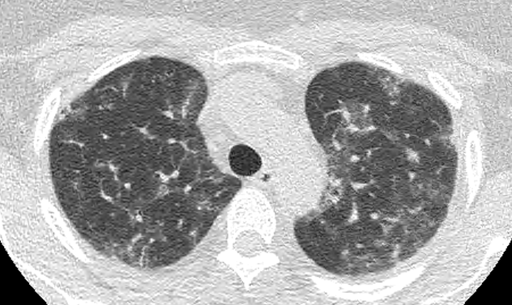

Slide 24
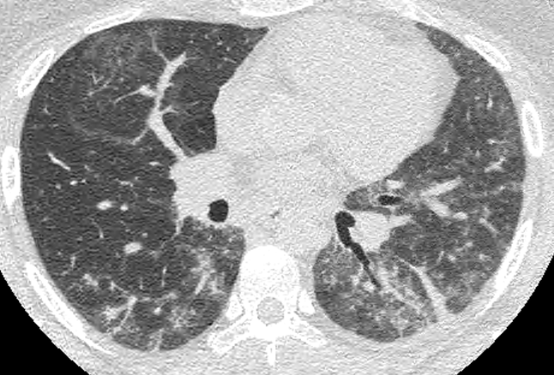

Slide 25
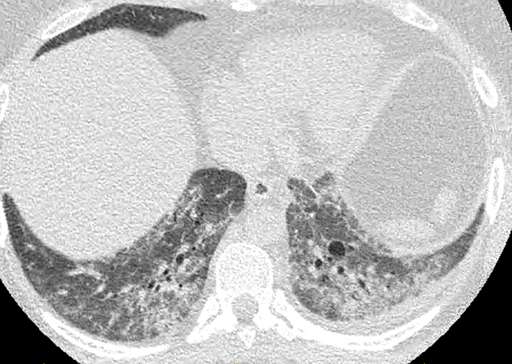

Slide 26
Michelle – Blood Tests
ANA and ANCA negative
CK normal
Ro52 and PL-12 antibody positive

Slide 27
Michelle – Management
Prednisone 75mg daily
Mycophenolate mofetil 1.5g BD
Prednisone slowly weaned to 10mg over months
Weight loss and referral to transplant team

Slide 28
Michelle– ‘take-home’ messages
Beware of the young person with interstitial lung disease
Myositis related interstitial lung disease progresses rapidly and requires urgent treatment
Myositis related ILD can be without symptoms of myositis – “amyopathic” – with normal peripheral examination and normal CK

Slide 29
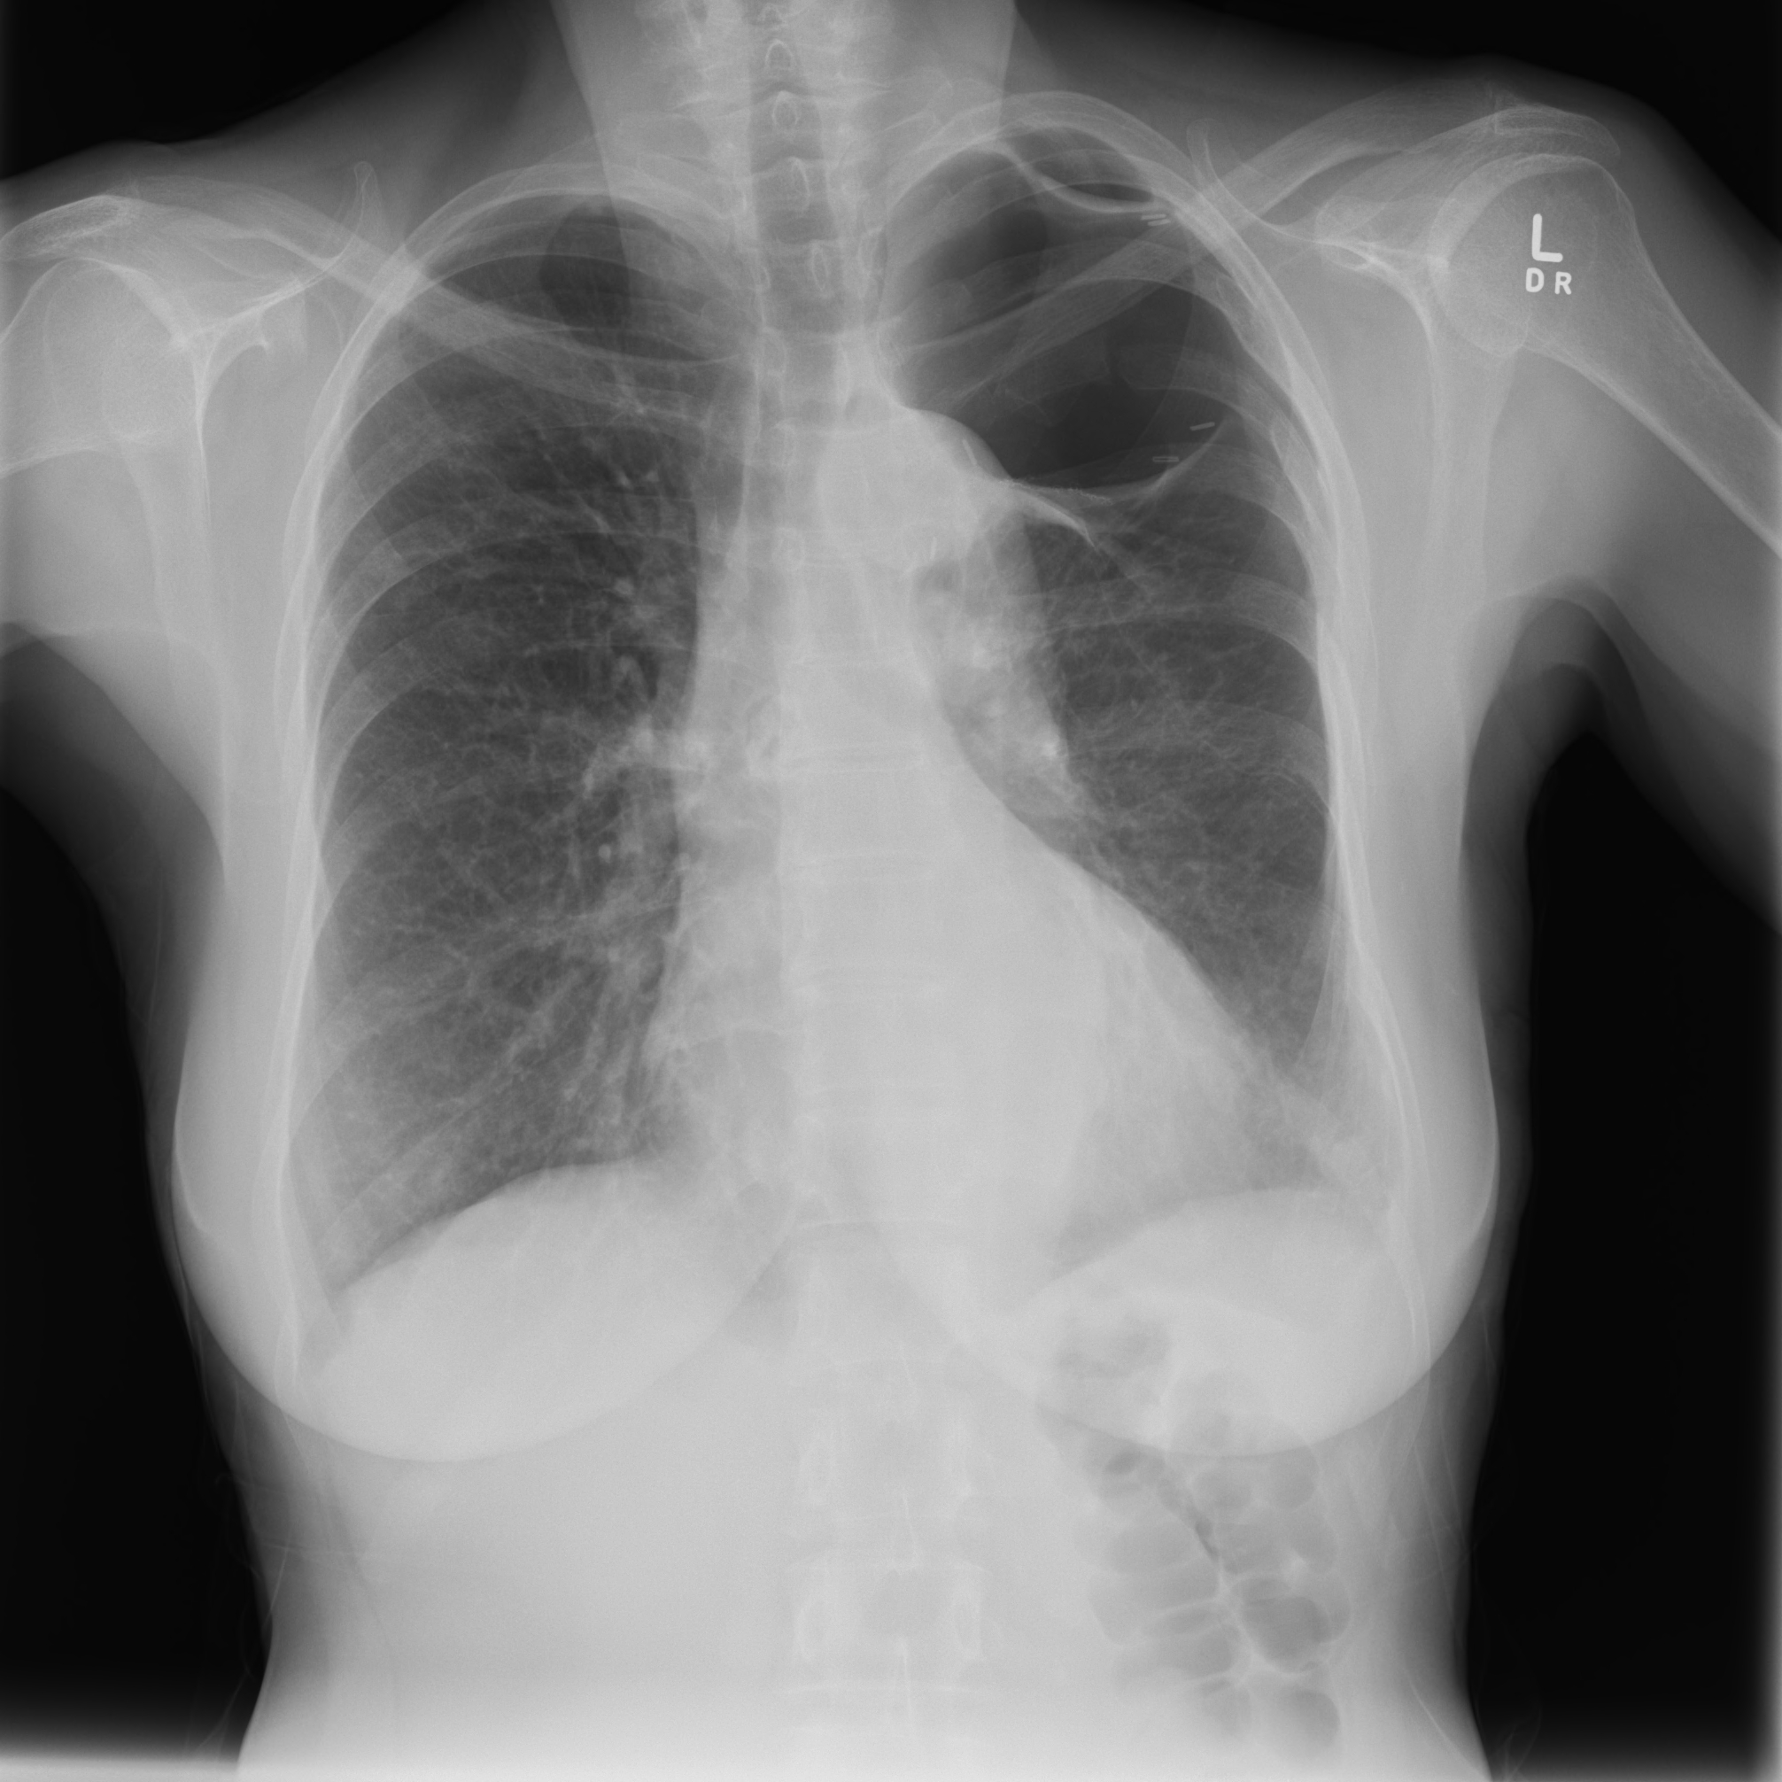
Case 3 - Mrs PL
Long standing RA
Refuses most meds apart from pred – A Doug Gray Special

Slide 30
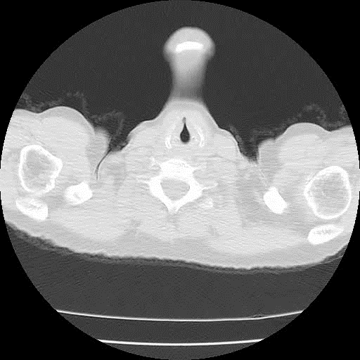
Mrs PL
Admitted to hospital with infective symptoms
Had to save her from the enthusiastic emergency staff and an ICC for her presumed PTX

Slide 31
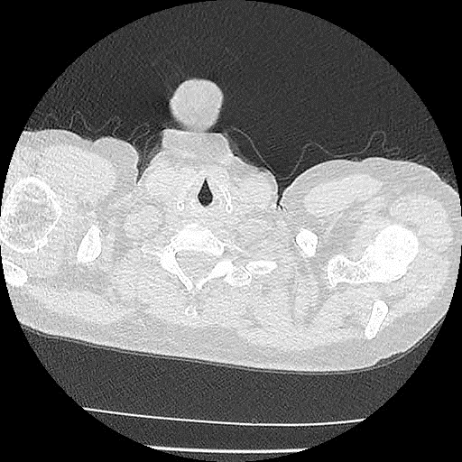
Mrs PL
Goes along for several years with minimal chest issues and low grade joint inflammation. Avoids Doug.
Presents with chest infection and joints that are now unbearable and wants chest infection treated so she can see Doug and get proper therapy.

Slide 32
Mrs PL
Sputum – Hyphae seen
Bronchoscopy – Staph. and more hyphae later confirmed to be Aspergillus
Aspergillus IgG mildly elevated
Confirms Diagnoses of Aspergilloma (presumed to be multiple) NOT Invasive Aspergillosis (rarely survived) or ABPA (no allergic response)
ESR 62
CRP 57
IgE low
RF 193
Anti-CCP 323
WCC 15 No Eosinophilia

Slide 33
Mrs PL
Treated with Itraconazole (Lozanoc 100mg) with an aim to continue for 6 months.
Seen by Doug with aim to commence Biologic therapy along with Arava
Aim to reduce to “Prophylactic” dose of 50mg Lozanoc from 6 month mark, forever most likely (evidence free zone)
Tolerating therapy well at present. Inflammatory markers falling and joint symptoms improving slowly

Slide 34
Case 1 Returns 3 years later – Jim (continued)
65-years-old and medically retired due to severe breathlessness.
Reports 3 admissions to hospital in the past 6-months with respiratory infections and exacerbations of IPF.
Stopped smoking 12 months ago.
Wheelchair bound due to breathlessness.
Primary complaint is chronic severe dyspnoea and now anxiety.

Slide 35
Jim– Functional assessment

Slide 36
Jim– Functional assessment
Arterial Blood Gas
  pH 7.40
  PO2 52mmHg
  PCO2 35mmHg
Trans thoracic echocardiogram
  Dilated right ventricle
  Pulmonary pressure 62mmHg

Slide 37
Jim – Palliative phase
How can we determine when Jim’s enters the palliative phase?
What can we do to manage severe dyspnoea and anxiety?
What services are available in the region?
What to expect – prognosis and issues along the way.

Slide 38
Case 3 – ‘take-home’ messages
Severe dyspnoea and respiratory compromise are hallmarks of
end stage pulmonary fibrosis.
Fibrosis in addition to severe pulmonary hypertension contribute to the burden of symptoms.
The palliative phase is often heralded by severe or recurrent exacerbations of lung disease. Objectively there may be sudden decline in lung function and evidence of active inflammation on a CT scan.
Multidisciplinary care including GP’s, Respiratory and palliative care nurses along with respiratory and palliative care physicians provide optimal care.

Slide 39

Health Pathways – Restrictive lung disease
A Partnership Program:​
- North Coast Primary Health Network​
- Northern NSW and Mid North Coast ​
Local Health Districts
manc.healthpathways.org.au ​
​
Username: manchealth​
Password: conn3ct3d​

Slide 40

Thanks for attending, thanks to our presenters and hope to see you at the next NorDocs webinar in 2021.

Slide 41


This webinar was bought to you by NorDocs
and powered by Cape Institute
www.capeinstitute.org.au

